Slide 1

Welcome to Year 5!

Slide 2
A bit about me!
This is my 4th year working at St Bernadette’s.
I am a Watford supporter and have a real interest in football despite not being the best at playing.
I love an animated film, making me a big kid at heart.
I have grown up with St Bernadette’s always being a part of my life (having attended the school as a child), so I know the school very well.
It has been 2 years since I last inherited a new class and I am looking forward to building relationships with a new group of families.

Slide 3
Staff in Year 5
Class Teacher - Mr Reeve
Cover Teacher - Miss Bell
Teaching Assistant - Mr Hill
Every teacher is given PPA time each week (planning, preparation and assessment time). My PPA is on a Tuesday morning until 10:45.
I will then be out of class from 10:45 until 12:15 for subject leadership time. Miss Bell will cover all morning from 8:40 - 12:15, every Tuesday.

Slide 4
Life in Year 5
The transition from Year 4 to Year 5 can feel daunting as the children become one of the older children in the school. Overall, things won’t be too dissimilar from Year 4.
The main difference between Year 4 and Year 5 is that the children will begin to prepare for SATS this year that they will take in Year 6. The maths may appear more challenging at first as concepts like percentages are introduced and fractions become slightly harder but there is nothing to worry about and all the children will be supported where needed.
Morning work tasks will focus on developing SATS skills and SATS questions will be implemented into maths, guided reading and literacy lessons where possible.

Slide 5
My aim by the end of Year 5!
All the children in the class will be ready and prepared for their final year at St Bernadette’s and that they will enter Year 6 confident and happy.

Slide 6
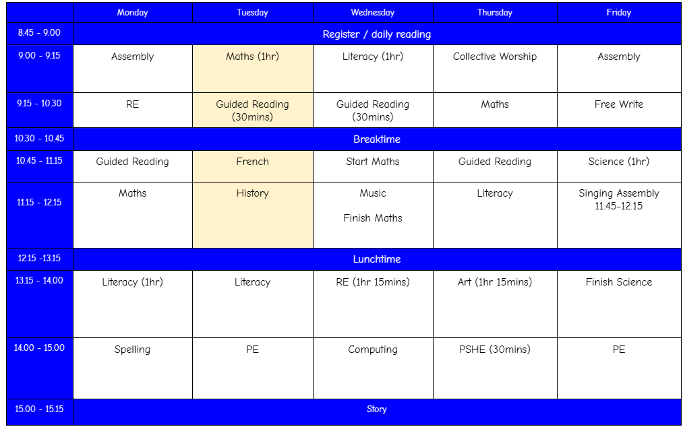
TIMETABLE

Slide 7
My expectations
Always try your hardest!
Give things a try before asking for help - a real emphasis on independence ahead of Year 6!
Follow the class rules - these were generated by the class!
Complete homework - especially reading and any work that has been set in preparation for our maths learning!
Enjoy Year 5 - the year will go by very quickly!

Slide 8
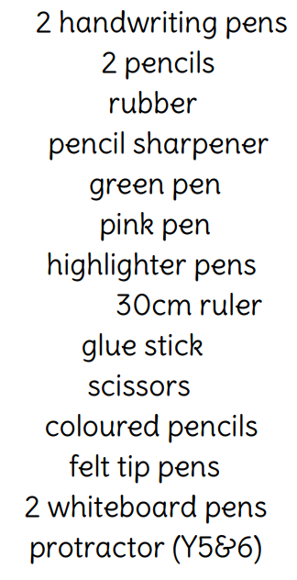
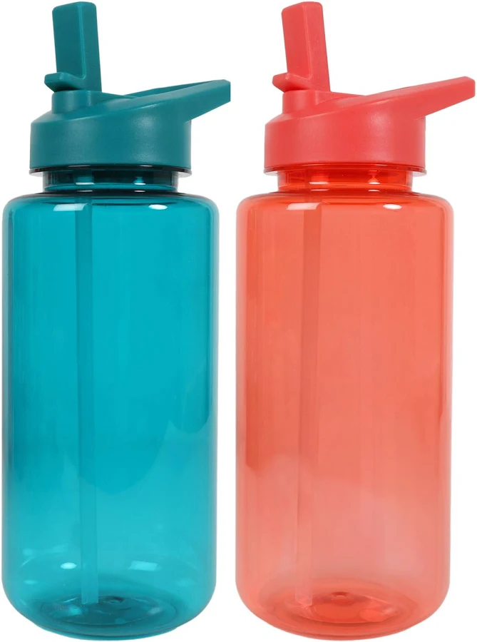
Equipment/Uniform
Please ensure that if your child is wearing a watch, that it is not a smart watch. Ideally, all children wearing watches should be wearing analogue watches only.
PE kit
Plain white t-shirt
Black short/leggings
Suitable trainers
Without a full PE kit, your child will be unable to take part in PE lessons for health and safety.
PLASTIC water bottles only please.

Slide 9
Trips
This year, Year 5 are expecting to go on the following trips:
Stem Discovery Centre (£23 estimated) - September 24th
A local walk to the River Colne (Free)
SPEC (£165 estimated) - SPEC stands for Spiritual and personal Encounter with Christ. The residential retreats are a 2-night experience offering younger people an opportunity to get to know God, themselves and each other in a deeper way. The SPEC retreat centre is located in Pinner, Harrow, North West London. We will have a meeting about this trip nearer the time. - 28th - 30th April

Slide 10
Nativity
This year, Year 5 will be given the main roles in the KS2 nativity.
We will begin to prepare for this at the end of this half term and into Autumn 2.
Feel free to begin preparing your child to take part in any capacity for this now to ensure that they feel as comfortable as possible with being on stage and performing in front of an audience.
KS2 Nativity - Wednesday 9th December

Slide 11
Communication
Google classroom - this is used to set homework, showcase children’s work and for general reminders.
If there are any concerns that you have or something that you wish to speak about privately please contact the office via: parents@stbernadette.herts.sch.uk
If you have a quick question, please feel free to grab me in the morning or at the end of the day, at the door. Please be mindful that both of these times can be particularly busy.

Slide 12
Social Media
In previous years, we have found that social media is discovered by some children in Year 5.
Please be mindful of age restrictions on different platforms.
A social media ban was introduced this year to prevent children under 16 accessing a range of platforms which should prevent them from being on social media.
Disputes on social media can be incredibly tricky for the school to support in resolving and therefore I am asking for your support to ensure these do not take place.

Slide 13
Homework
Homework is set every Friday and will follow the following format:
Reading at least 3 times a week and recorded in reading records. These will be checked every Wednesday and reading books will also be changed on a Wednesday as well.
TTRS - this will be used as a platform to keep your children familiar with the times tables that they have learnt in previous school years.
Watch the pre-learning video that has been set for maths. There will not always been one of these every week.
Spelling Shed - 1 task set weekly.
5 weekly spelling words, which the children are required to know by the end of Year 6, will be posted with the homework every Friday. We will complete some activities in class to help them learn these but we also ask that you do some informal practice with them at home.

Slide 14
100 book challenge
This is something that we will continue to promote this year within the school.
Please remind your child to engage with this outside of school and encourage them to read these books where possible.
Take them to the local library to source some of the books that we may not have available in school at this current time.
It would be great to complete as many of these as possible as a class and be able to celebrate with some form of reward for completing the most across the school.

Slide 15
Behaviour
House points - these are used for positive behaviour and for those who consistently follow the St Bernadette 5B’s.
Merits - these are used for exceptional pieces of work or stand out achievements. If your child has achievements from outside of school that they would like to celebrate, please send them into school with certificates and trophies and these will be celebrated with the whole school. These do not just have to be for sporting achievements.
Roll of Honour - these are used to celebrate effort throughout the week and to celebrate progress made in class.
Marble Jar - these are used to celebrate whole class behaviour. Once this is filled, it will result in some form of reward which is usually chosen by the class.

Slide 16
Behaviour
In line with the school behaviour policy, if a child is not following the class rules, they will receive a verbal warning. 3 warnings will result in time being spent in Year 6 with Mrs Bennett.
Should behaviour not improve upon return to class, they will then be sent to the headteachers.
If I have any concerns with your child’s behaviour, I will communicate this with you on the day if possible. If not, I will communicate this with you at the nearest convenient time.

Slide 17
Prize box
A behaviour system that I have implemented in class has been a random wheel system.
The children can accumulate entries on to the wheel in class each day by showing positive behaviours such as:
Being ready to learn
Directing attention to me when I want the class to come back together
Completing fantastic work
General politeness
Supporting their peers
These are just some examples of positive behaviour that I look out for.

Slide 18
Prize box
At the end of each month, I will spin the wheel 10 times and if it lands on your child’s name, then they will be able to select something from the box.
The more entries that they earn, the higher the chance of the wheel landing on their names.
It is all about standing out amongst the other children in the class. I adopt a very positive approach to behaviour in class, always identifying those who are making positive choices.

Slide 19
Walkers/ End of the Day
In Year 5, your child is able to walk home with your permission. If you would like your child to walk home by themselves, please email the office. If the office do not receive an email with your permission, I will be unable to release your child at the end of the day!
If you have arranged for your child to be collected by someone else, please communicate this with the office as well.
Please note, your child can not be released to someone under the age of 16!

Slide 20
Final reminders
Please see the Year 5 page on the school website for a more in depth breakdown of what will be covering in class this year.

Slide 21
Thank you for your support already and I am confident that this is going to be a very successful year together.

