Slide 1


Welcome to Year 2

Slide 2
A little about me…
I’m not from the local area. I’m from Southport, near Liverpool.
I support Liverpool but my husband is a Spurs supporter - so I’ll allow these football kits but that’s it!!
I have 2 children, Tess and Flynn. Tess is 7 and Flynn is 4. So like you I spent my summer holiday going around zoos, farms, parks.
I have been teaching for 13 years and have spent most of that in either year 5 or year 6, however I did teach year 2 last year- so I am pretty familiar with the curriculum.

Slide 3
This is my 6th year teaching at St Bernadette’s.
However I am still navigating being both parent and teacher. Tess has just started year 3 and Flynn has just started Reception, so I do understand how it feels to be a parent and having children go through the education system.
Roles in the school:
RE lead
KS1 Lead

Slide 4
Life in Year 2
Life in Year 2 is not too dissimilar to Year 1, so the transition for the children should be pretty smooth. I spent some time with the children during the summer term so we already know each other.
Maths may become a little more challenging for them, as we introduce new concepts like time (watch - Christmas idea!) and fractions but there is nothing to worry about.
My hope is that by the end of the year, all the children will be ready for their first year in KS2 and will go into year 3 confident and happy.

Slide 5
Other teaching staff:
TA: Mrs A (Monday - Friday)
Other teaching staff:
Miss Rickard (Mon- Fri AM only)
Mrs Fitzgerald (Mon - Fri 1-2 only)
Mrs Plant (Mon - Friday 10:45-11:45)
KS1 leadership time: Wednesday afternoon Miss Weston (1 hour)
PPA is on a Thursday afternoon, so Miss Bell will be dismissing the children every Thursday.

Slide 6
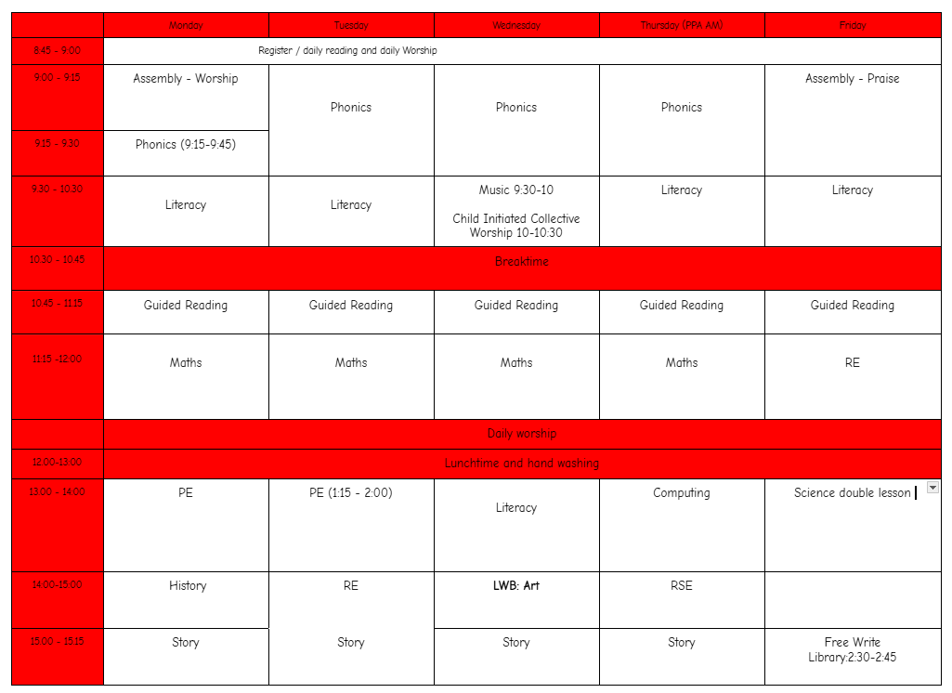

Slide 7
Autumn term: Literacy
Literacy Reading - Reading comprehension will play an important role in Year 2. Please ensure you try to listen to your child read at least 5 times a week for 15 mins minimum. Please record in their reading journals.
Each table will get their books changed once a week- your child should know what day their book gets changed (Friday).
Literacy Writing - Children will have an opportunity to write for different audiences and learn a range of topics. They will explore setting description, instructions, poetry and tales and legends.
Children will also develop a further understanding of spelling, grammar and punctuation and will be completing phonics lesson everyday. We start spelling lessons in the Spring term.

Slide 8
Autumn term: Maths
We use the scheme ‘Maths No Problem’
We will be completing investigation lessons for each topic, this gives the children a chance to use what they have been learning and use it in a practical activity/group activity.
Focus for Autumn:
• Numbers to 100
• Addition and subtraction
• Multiplication of 2, 5 and 10
• Division of 2, 5, 10

Slide 9
Autumn term: Other topics
RE: Creation and Covenant
History: The Great Fire of London.
Geography: London
Science: Living things and their habitats.
Art: Craft and design: Map it out.
Computing: Coding and online safety
PE: Striking and fielding, dance and ball skills.

Slide 10
How to support:
• Support them with their homework if needed and encourage a high standard of presentation. Handwriting is a BIG focus this year.
• Listen to them read, making sure to log their reading in their reading journals. PLease try and do this 5 times a week - As a little incentive, I have prizes for the children who do this.
• Ensure PE kit is in school every day
• Ensure children are ready for learning with all correct equipment. If you could help by giving your child a glue stick, that would be great.

Slide 11
My Expectations
- Children try their best in everything they do
- They follow the class rules
- They are kind to each other
- They complete homework
- They are prepared (PE kits etc)
- No digital watches
- No fidget toys (unless agreed with SENCO)
- No metal water bottles.
- They enjoy Year 2!

Slide 12
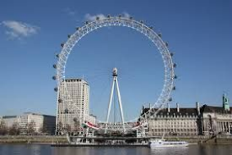
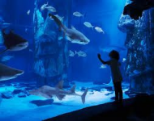
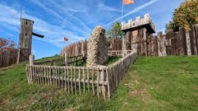
Library: We will visit the school library once a week. If your child has finished their book, they can swap it but they will need to return it before they can take out another book. This book is in addition to their reading book.
Trips:

Slide 13
Communication
I will use Google classroom to set homework, showcase children’s work, photos and for general reminders e.g. class parties etc.
It is not a form of communication for parents to message staff on. If you do need to speak to me you can email the office and they will let me know.
Please be mindful that the end of day can be very busy and there are lots of children and parents around, so if you need to discuss anything important then the end of the day at the classroom door is not the best time or place. I am happy to arrange a meeting before or after school or a phone call during lunch break.

Slide 14
Homework
Homework should be uploaded onto Google Classroom. If you any ‘technical’ problems with Google classroom, again please let me know. I’m not the best with technology but I will try and help you..… or find another member of staff who can!
Homework is all about pre-teaching. The majority of it will be videos to watch. There will be some SPAG and maths games and a half term writing task. Logins can be found in the front of their reading records.
I will not be setting any projects for homework - however this term we are learning about the Great Fire of London. I will be asking children to create a house (made out of cardboard and paper only) we will then create our own Pudding Lane and safely set fire to them - so please do not spend much time on the house!

Slide 15
Class Bee and Prayer Bear:
The class Bee will come home once this year. The idea is the children demonstrate one of the St Bernadette values.
Be kind
Be motivated
Be resilient
Be respectful
Be Independent
All I ask is you take a photo and email it into the school office. I will print it off and the children will write about it during morning work.
Prayer Bear: Will come home once also.

Slide 16
Behaviour:
Children will get 3 verbal warnings. If they still are not choosing to do the right thing then they will be sent to a key stage leader.
A reflection form is completed and the KS leader will check in with that child again throughout the week- hopefully giving lots of praise for their wonderful behaviour.
If the child continues to do the wrong thing that day, then they are sent to Ms Constantinou (SENCO) and if the behaviour continues then they are sent to the Head Teachers office.

Slide 17
100 books to read before you leave St B challenge.
In the school office area, there is a large display, showcasing the 100 books. The ideas is that the children should strive to read all 100 books before they leave Year 6, and there are awards for reaching the milestones of: 25 books, 50 books, 75 books, and 100 books. The children will have a reading journey folder that will stay in school, and will follow them all the way through their school life.
You will receive an email shortly with more information about the challenge, but for each book the children read, they should complete a book review. These templates will be found in the office, in their classrooms, on Google Classroom and on the school website.
You can support your child in the challenge by:
● Talking to them about the challenge and encouraging them to read as many books as possible.
● Supporting them to complete the book reviews if they need help.
● Taking them to the local library or book shop to find some of the books on the list to read.
Any book reviews completed must be returned to their folder which is kept in school.

Slide 18
Going Home:
Please let me know if it will be someone else other than yourself will be picking up.
Please don’t assume that because you may know parents in other year groups, I do because I don’t.
If your child is getting picked up by someone else, please let me know either at morning drop off or email/call the school office. If you don’t do this, I cannot let your child go home with them until I have spoken to you.

Slide 19

Any questions?

